Slide 1




Welcome To
A new world of fitness

Slide 2
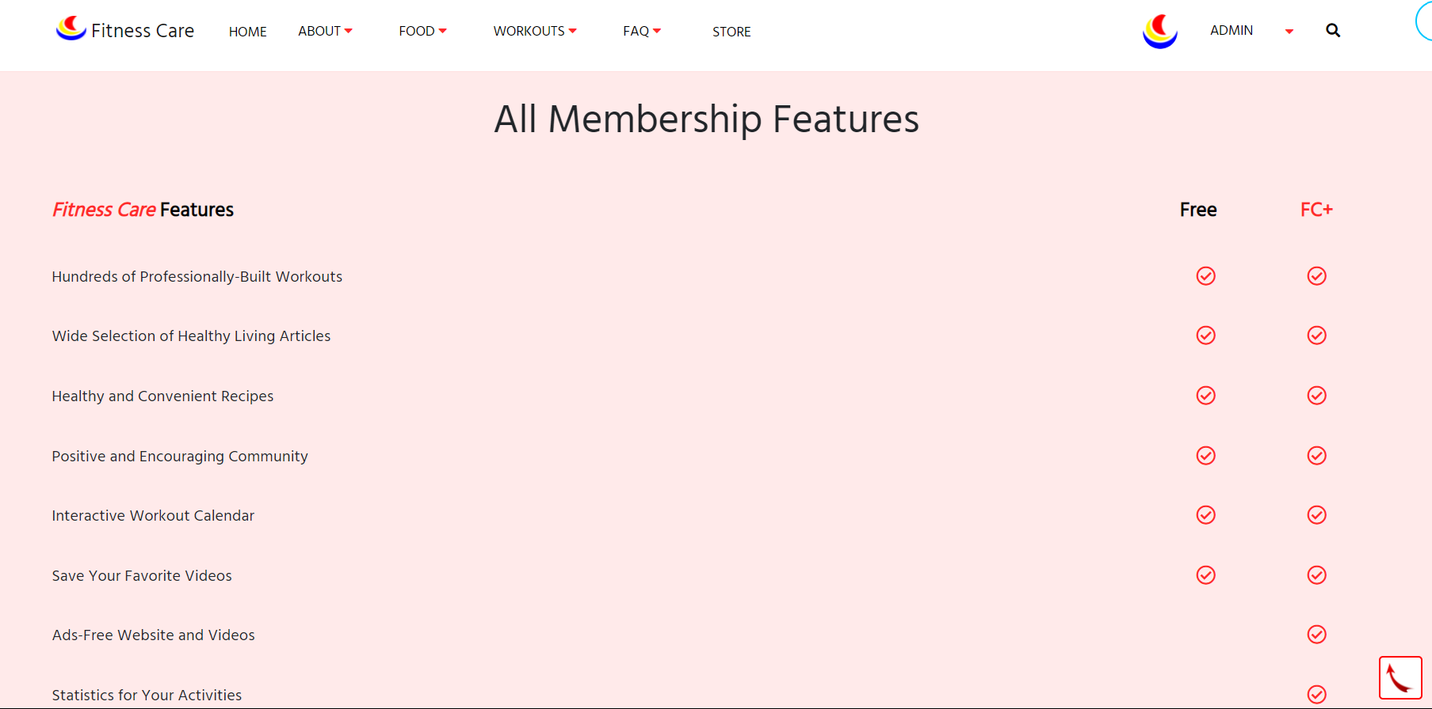
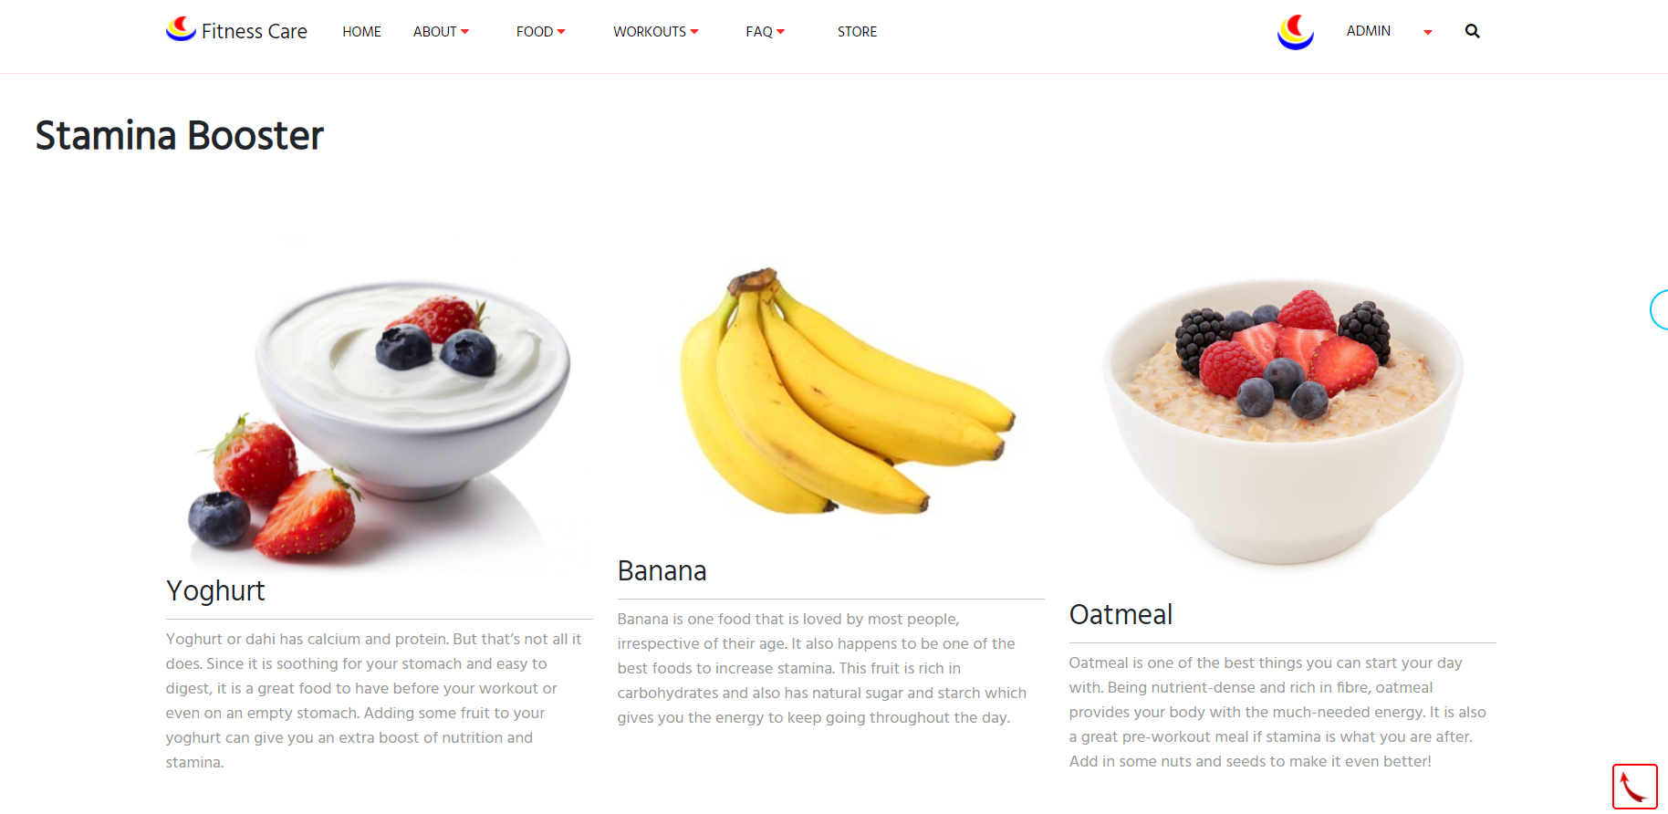

Nutrition
Learn more about how to healthily fuel your body and your life with content from registered dietitians, and certified personal trainers.

Slide 3

CONTACT US
If You have any problems with our website. You can tell us from this page.

Slide 4
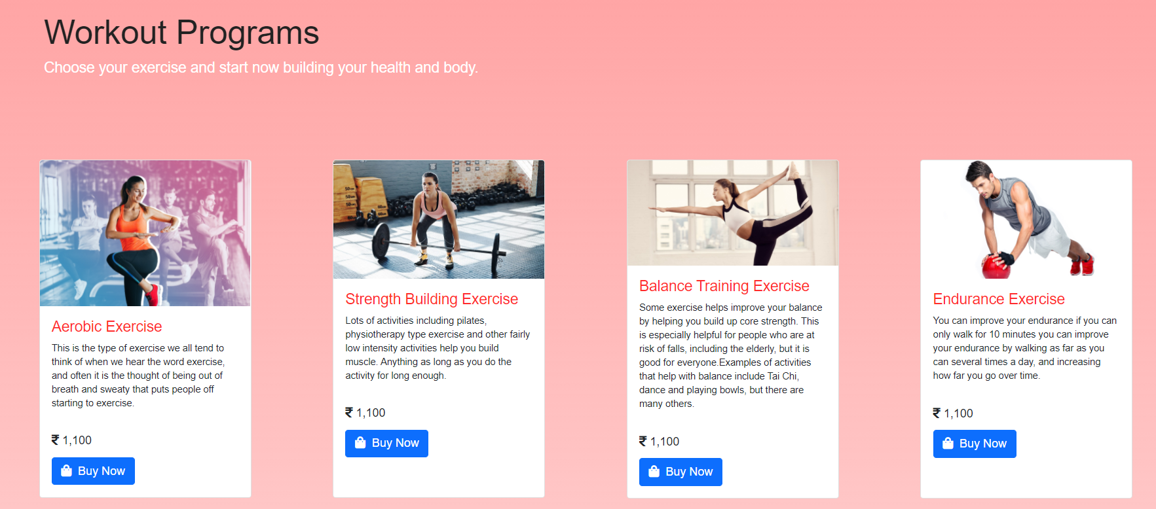
WORKOUT PROGRAMS

Slide 5

DASHBOARD
After the login you will be redirect to dashboard.

Slide 6

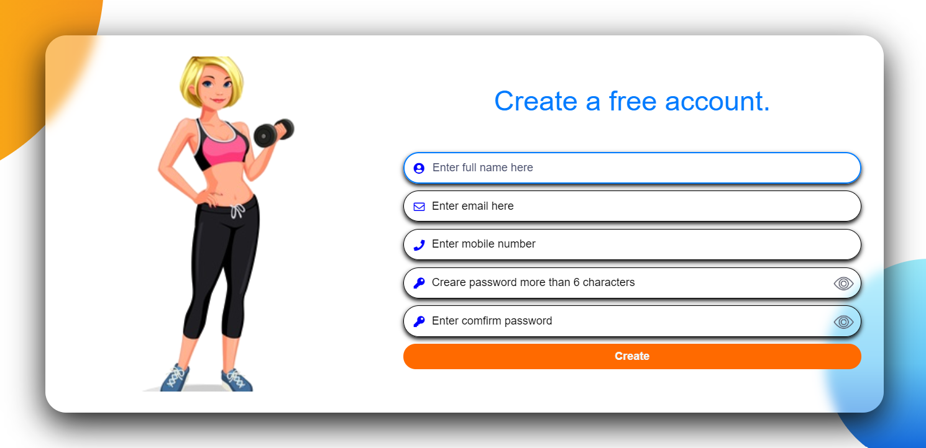
Login & sign up

Slide 7
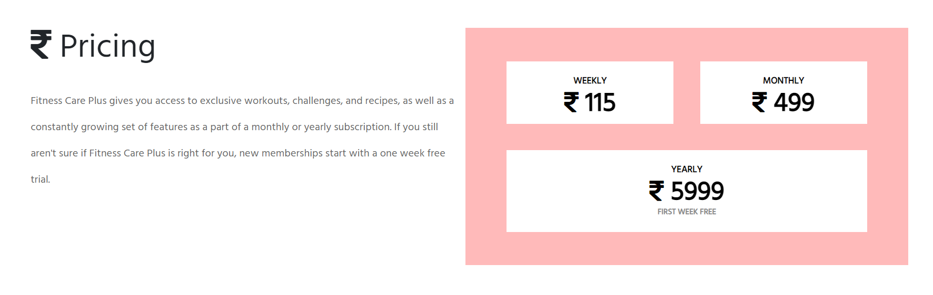
MEMBERSHIP
There are some membership feature for user.

Slide 8
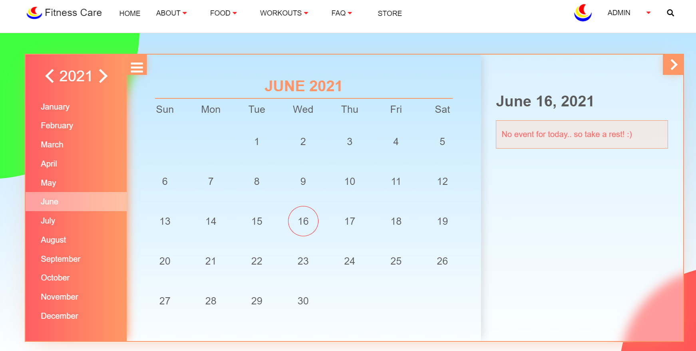
events
There are a calendar base events plan for exercise and fitness activities.

Slide 9

careers
If you want to be part of Fitness Care. You can join us as a couch.

Slide 10
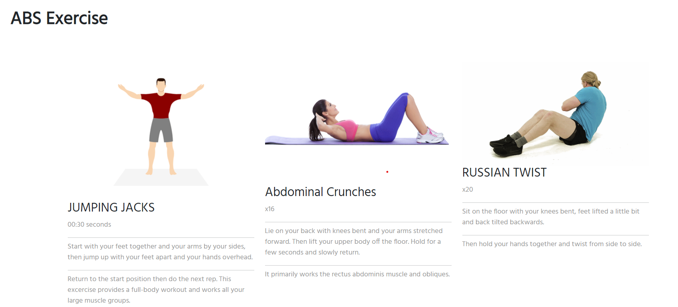

EXERCISE
You can simply find the exercise tutorials on this page.

Slide 11

STORE
Our website has a store for premium users and you will get lot of eGift card for shopping and purchasing our plans.

Slide 12
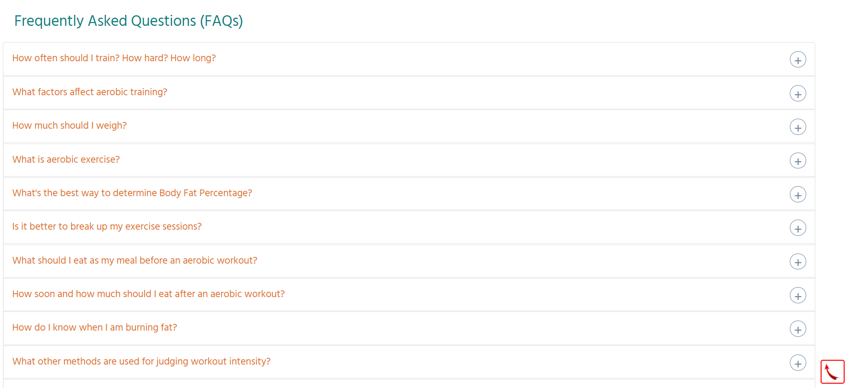
Frequently ASKED QUESTIONS

Slide 13
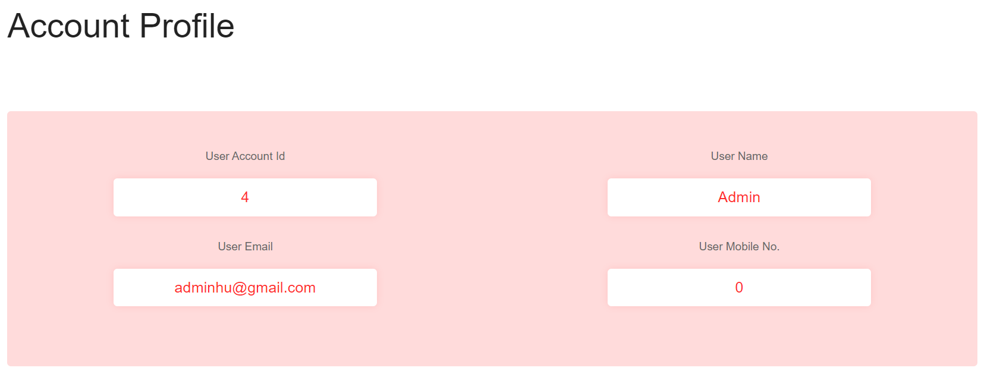
USER PROFILE

Slide 14
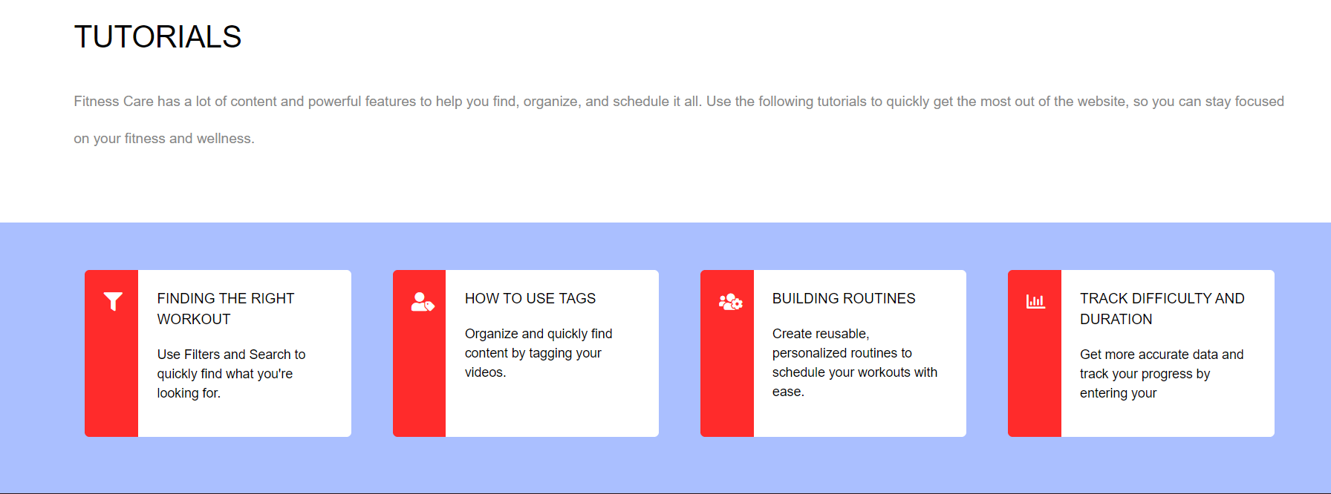
TUTORIALS
Fitness Care has a lot of content and powerful features to help you find, organize, and schedule it all. Use the following tutorials to quickly get the most out of the website, so you can stay focused on your fitness and wellness.

Slide 15
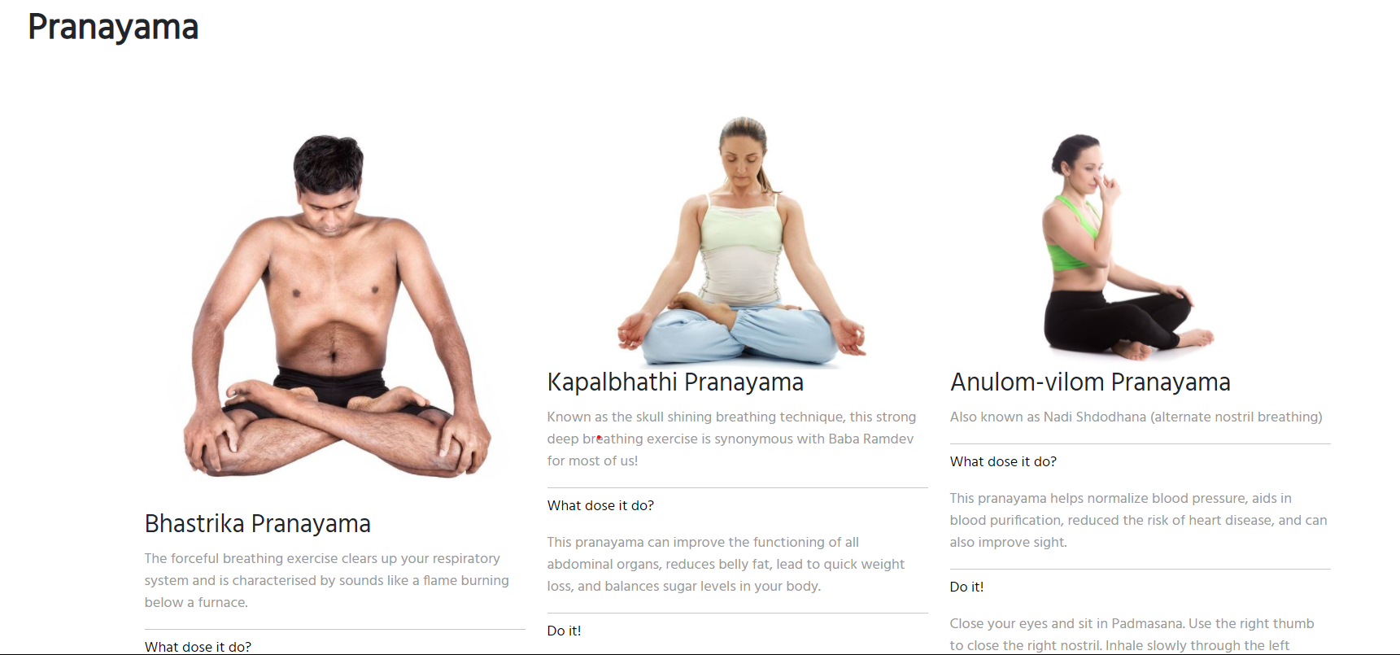
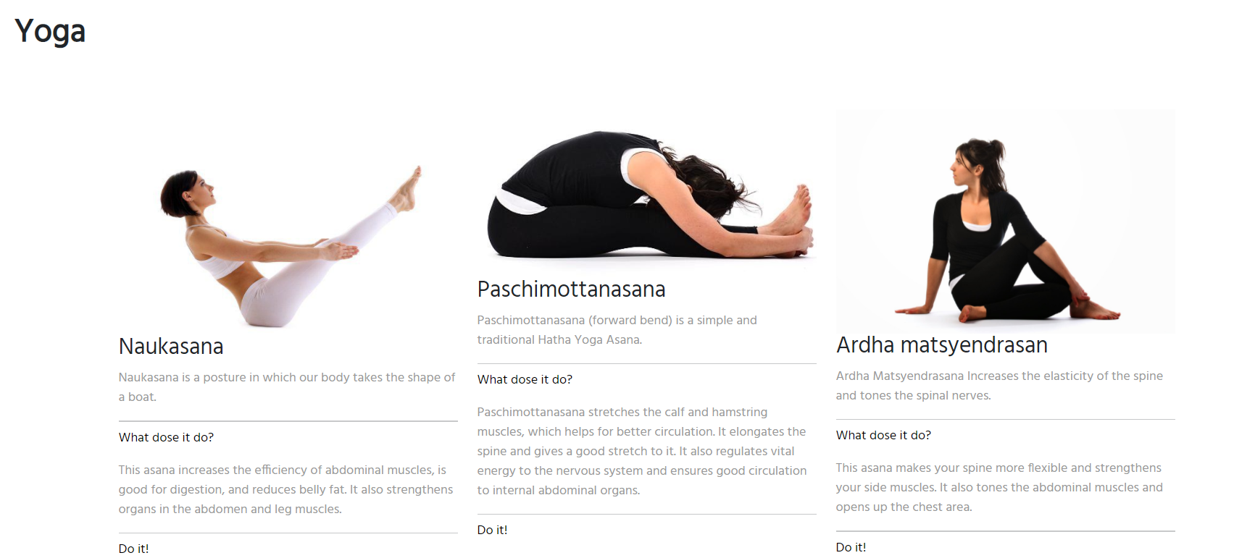
YOGA
Yoga se hi hoga.

Slide 16
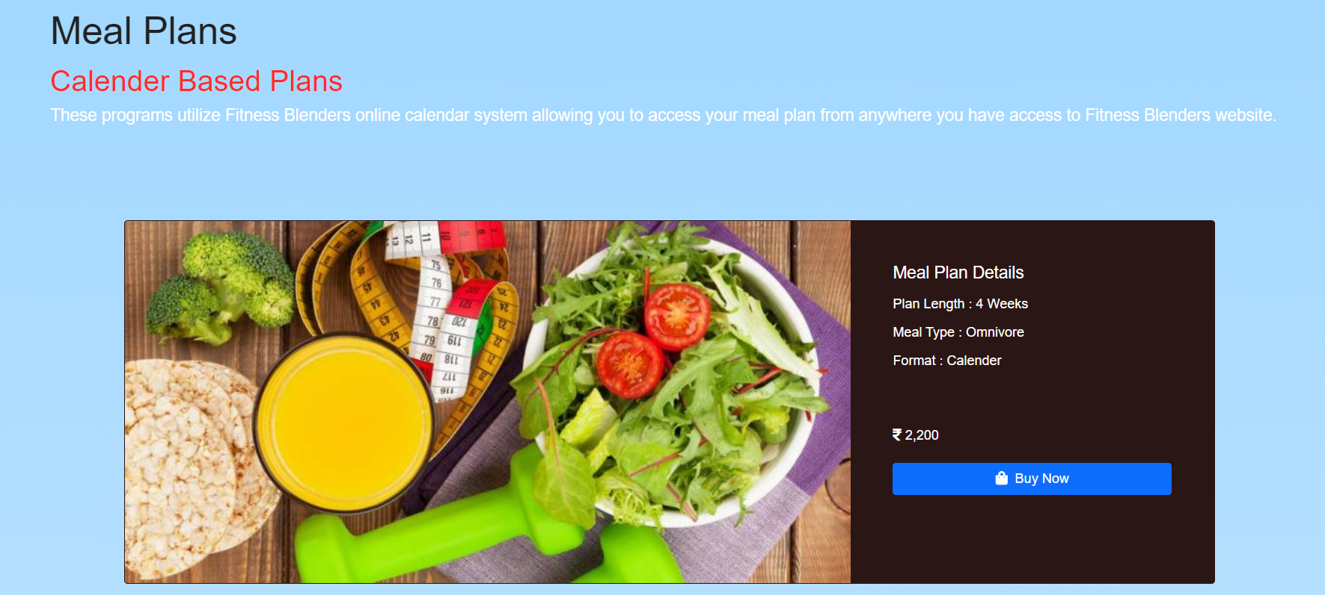

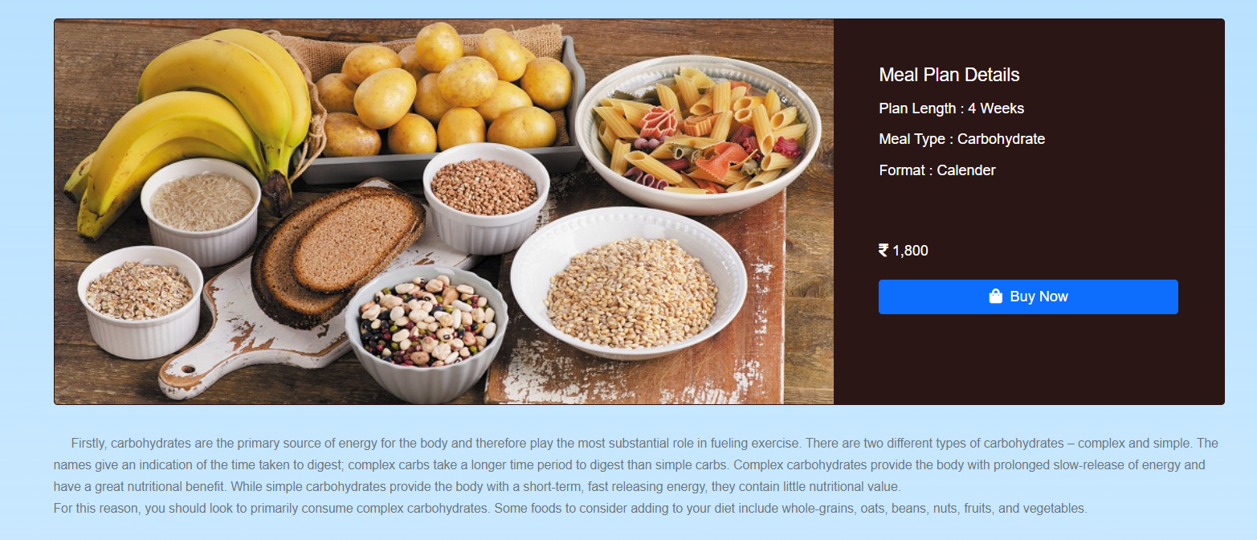
MEAL PLANS
Learn more about how to healthily fuel your body and your life with content from registered dietitians, and certified personal trainers.

Slide 17
THANK YOU
GROUP MEMBERS
1. BEKROM ROY
2. ANURAG KUMAR SINGH
3. SAURABH JHA
4. MALIK KUMAR
5. HARIKESH KUMAR KORI
6. SAHIL GAURAV
7. AMRITANSHU KUMAR SINGH

